Slide 1


EPAM Node.js course
net module - asynchronous network API
2017

Slide 2
Agenda
1
OSI Model, Transmission Control Protocol (TCP)
2
Standard Node.js NET module overview
3
Simple TCP server and client
4
TCP echo server and client
5
Error handling
6
IPC (interprocess communication) in NET module
7
Additional information
Notes:
2

Slide 3
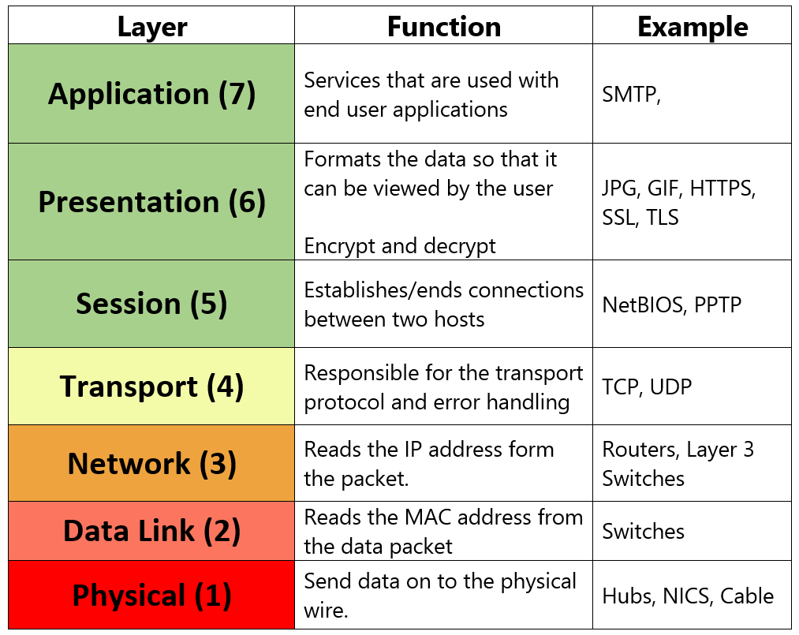
Open Systems Interconnection model (OSI Model)
Notes:
3

Slide 4
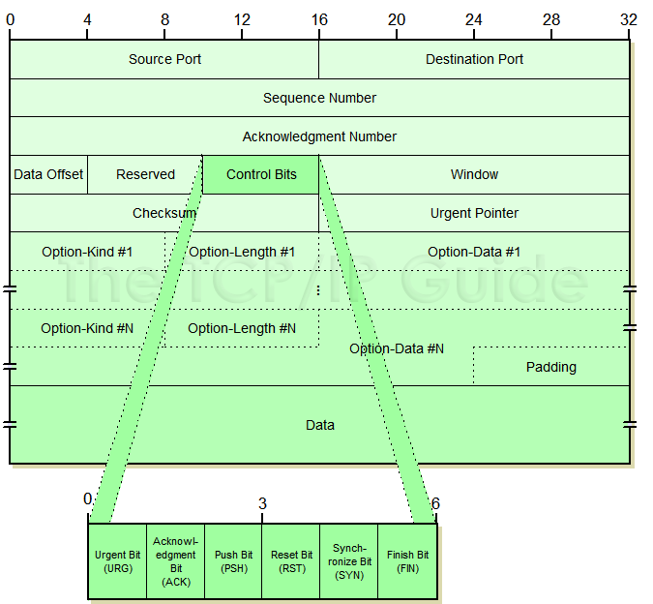
Transmission Control Protocol (TCP)
Notes:
4

Slide 5
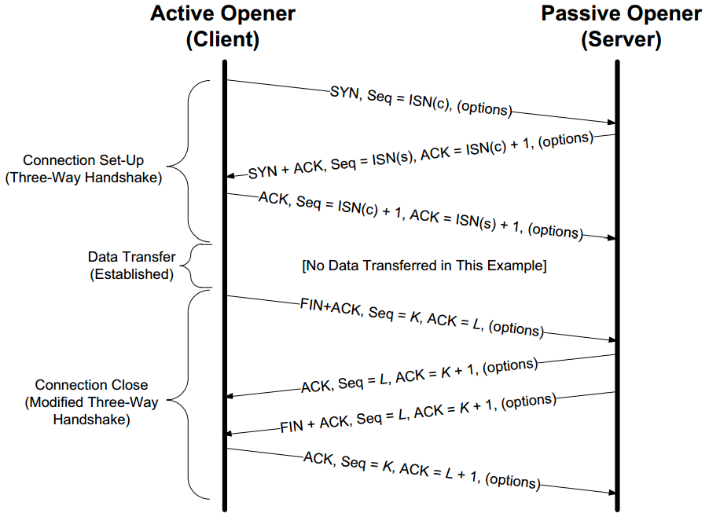
Transmission Control Protocol (TCP)
Notes:
5

Slide 6
TCP Socket Programming in Node.js
Net module
2017

Slide 7
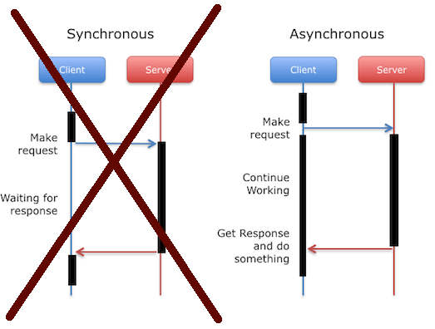
Node.js net module
The net module provides asynchronous network API
Notes:
P37 – divide into 2 slides
7

Slide 8
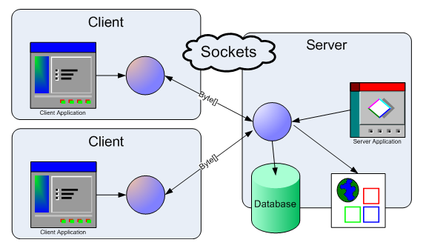
Net module

Slide 9
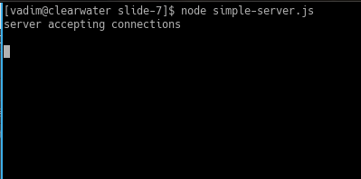
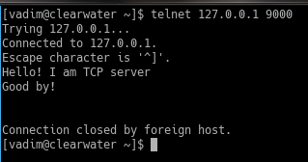
Simple TCP server
1 const net = require('net'); 2 const server = net.createServer({}, (socket) => { 3 console.log('connection from client'); 4 socket.write('Hello! I am TCP server\n');
5 6 setTimeout(() => { 7 socket.end('Good by!\n\n\n'); 8 }, 1000); 9 }); 10 11 server.listen(9000, 'localhost', 2); 12 13 server.on('listening', () => { 14 console.log('server accepting connections\n'); 15 });
net.createServer([options], [connListener])
options: {
allowHalfOpen: Boolean,
pauseOnConnect: Boolean
}
connListener — Function
Notes:
P37 – divide into 2 slides
9

Slide 10
Simple TCP server (with ‘connection’ event listener)
1 const net = require('net'); 2 3 const server = net.createServer(); 4 5 server.listen(9000, 'localhost', 2); 6 7 server.on('listening', () => { 8 console.log('server accepting connections\n'); 9 }); 10 11 server.on('connection', (tcpSocket) => { 12 console.log('connection from client'); 13 tcpSocket.write('Hello! I am TCP server\n'); 14 15 setTimeout(() => { 16 tcpSocket.end('Good by!\n\n\n'); 17 }, 1000); 18 });
net.createServer([options], [connListener])
server.on('connection', callback);
Notes:
P37 – divide into 2 slides
10

Slide 11
Simple TCP server (with ‘connection’ event listener)
const net = require('net'); const server = net.createServer(); server.listen(9000, 'localhost', 2); server.on('listening', () => { console.log('server accepting connections\n'); }); server.on('connection', (tcpSocket) => { console.log('connection from client'); tcpSocket.write('Hello! I am TCP server\n'); setTimeout(() => { tcpSocket.end('Good by!\n\n\n'); }, 1000); });
For TCP servers:
server.listen([port][, host][, backlog][, callback])
For IPC servers:
server.listen(path[, backlog][, callback])
Notes:
P37 – divide into 2 slides
11

Slide 12
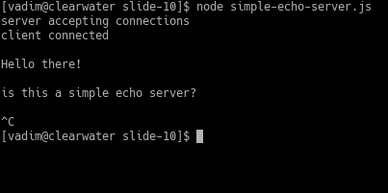
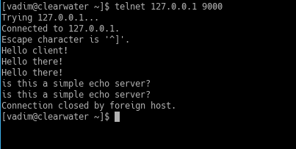
Simple TCP echo server
const net = require('net'); const server = net.createServer(); server.listen(9000, 'localhost', 2); server.on('listening', function () { console.log('server accepting connections'); }); server.on('connection', (socket) => { console.log('client connected\n'); socket.write('Hello client!\n'); socket.on('data', (data) => { console.log(data.toString()); }); socket.pipe(socket); });
socket instanceof stream.Duplex === true;
socket.write(data[, encoding, callback])
socket.pipe(destination[, options])
Notes:
P37 – divide into 2 slides
12

Slide 13
Simple TCP client
const net = require('net'); const clientSocket = net.connect(9000, localhost); clientSocket.on('connection', () => { console.log('connected to server\n'); }); clientSocket.on('data', (data) => { console.log(data.toString()); }); clientSocket.on('end', () => { console.log('disconnected from the server\n'); });
net.connect() aliases to net.createConnection().
net.connect(port[, host][, connectListener]) for TCP connections.
net.connect(path[, connectListener]) for IPC connections.
Notes:
P37 – divide into 2 slides
13

Slide 14
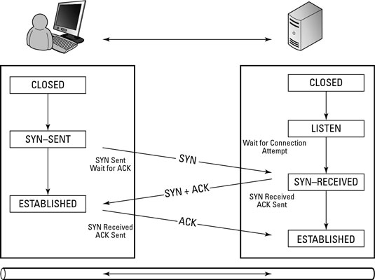
Transmission Control Protocol (TCP)
Notes:
14

Slide 15
Simple TCP client (echo server)
const net = require('net'); const socket = net.connect({port: 9000}); socket.on('connect', () => { console.log('connected to server!'); }); socket.on('data', (data) => { console.log(data.toString()); }); process.stdin.pipe(socket); process.stdin.on('data', (data) => { const str = data.toString(); if (str.trim() === 'exit') { socket.end('good by'); process.exit(); } }); process.on('SIGINT', () => { console.log('Caught interrupt signal'); if (socket) { socket.end('terminated'); process.exit(); } });
socket.end([data][, encoding]);
socket.end('good by') is equivalent to calling:
socket.write(data, encoding) followed by socket.end()
Notes:
P37 – divide into 2 slides
15

Slide 16
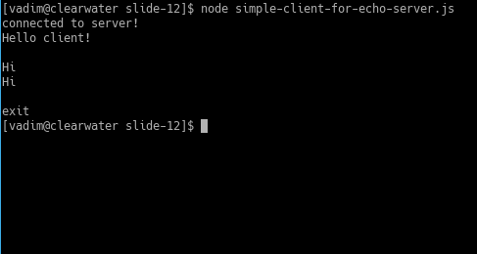
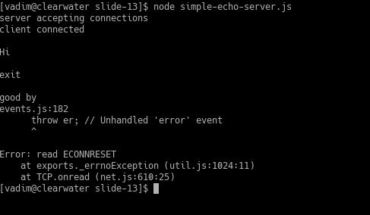
Simple TCP client (echo server)
const net = require('net'); const socket = net.connect({port: 9000}); socket.on('connect', () => { console.log('connected to server!'); }); socket.on('data', (data) => { console.log(data.toString()); }); process.stdin.pipe(socket); process.stdin.on('data', (data) => { const str = data.toString(); if (str.trim() === 'exit') { socket.end('good by'); process.exit(); } }); process.on('SIGINT', () => { console.log('Caught interrupt signal'); if (socket) { socket.end('terminated'); process.exit(); } });
Notes:
P37 – divide into 2 slides
16

Slide 17
Error handling
const net = require('net'); const socket = net.connect({port: 9000}); socket.on('connect', () => { console.log('connected to server!'); }); socket.on('data', (data) => { console.log(data.toString()); }); socket.on('close', (hadError) => { process.exit(); }); process.stdin.pipe(socket); process.stdin.on('data', (data) => { const str = data.toString(); if (str.trim() === 'exit') { socket.end('good by'); } }); process.on('SIGINT', () => { console.log('Caught interrupt signal'); if (socket) { socket.end('terminated'); } });
const net = require('net'); const server = net.createServer(); server.listen(9000, 'localhost', 2); server.on('listening', function () { console.log('server accepting connections'); }); server.on('connection', (tcpSocket) => { console.log('client connected\n'); tcpSocket.write('Hello client!\n'); tcpSocket.on('data', (data) => { console.log(data.toString()); }); tcpSocket.on('error', (error) => { console.log('Connection error: ', error.stack); });
tcpSocket.on('end', () => { console.log('FIN frame received'); }); tcpSocket.on('close', () => { console.log('Connection ended'); }); tcpSocket.pipe(tcpSocket); });
Notes:
P37 – divide into 2 slides
17

Slide 18
IPC Support in Net module
2017

Slide 19
UNIX domain socket / Named pipes (server)
1 const net = require('net'); 2 const path = require('path'); 3 let namedPipe; 4 5 if (process.platform === 'win32') { 6 namedPipe = '\\\\.\\pipe\\pipe.name'; 7 } else { 8 namedPipe = path.join(__dirname,'pipe.name'); 9 } 10 11 const unixServer = net.createServer(); 12 unixServer.listen(namedPipe); 13 14 unixServer.on('connection', (ipcConnection) => { 15 console.log('client connected\n'); 16 ipcConnection.write('Hello client!\n'); 17 18 ipcConnection.on('data', (data) => { 19 console.log(data.toString()); 20 }); 21 22 ipcConnection.on('error', function(err) { 23 console.log(err); 24 }); 25 26 ipcConnection.pipe(ipcConnection); 27 });
server.listen(path[, backlog][, callback])
Start a IPC server listening for connections on the given path.
server.listen([port][, host][, backlog][, callback])
Start a TCP server listening for connections on the given port and host.
Notes:
P37 – divide into 2 slides
19

Slide 20
UNIX domain socket / Named pipes (client)
const net = require('net'); const path = require('path'); let namedPipe; if (process.platform === 'win32') { namedPipe = '\\\\.\\pipe\\pipe.name'; console.log(namedPipe); } else { namedPipe = path.join(__dirname, 'pipe.name'); } const socket = new net.Socket(); socket.connect(namedPipe, () => { console.log('Connected to the server!'); }); socket.on('data', function (data) { console.log(data.toString()); }); process.stdin.pipe(socket); process.stdin.on('data', function (data) { if (data.toString().trim() === 'exit') { socket.end('good by'); } }); socket.on('end', () => { console.log('end'); process.exit(); });
net.connect(path[, connectListener])
net.createConnection(path[, connectListener])
Initiates an IPC connection
net.connect(port[, host][, connectListener])
net.createConnection(port[,host],connectListener])
Initiates a TCP connection
Notes:
P37 – divide into 2 slides
20

Slide 21
Usuful methods
socket.address() – returns @object e.g. { port: 12346, family: 'IPv4', address: '127.0.0.1' }
socket.setKeepAlive([enable][, initialDelay]) — returns the socket itself.
socket.setTimeout(timeout[, callback]) — returns the socket itself.
socket.setTimeout(3000);
socket.on('timeout', () => {
console.log('socket timeout');
socket.end();
});
socket.setEncoding([encoding]) — returns the socket itself.
socket.bytesWritten
socket.bytesRead
Notes:
P37 – divide into 2 slides
21

Slide 22
Useful links
https://nodejs.org/dist/latest-v8.x/docs/api/net.html - The net module documentation
https://nodejs.org/api/dgram.html - The dgram module provides an implementation of UDP Datagram sockets.
https://www.npmjs.com/package/node-ipc - node-ipc module
https://msdn.microsoft.com/ru-ru/library/windows/desktop/aa365783(v=vs.85).aspx - Pipe Names
https://support.microsoft.com/en-in/help/103884/the-osi-model-s-seven-layers-defined-and-functions-explained - The OSI Model's Seven Layers Defined and Functions Explained
Notes:
P37 – divide into 2 slides
22

